Slide 1
Team Introduction
The Fitness & Well-being Dashboard project is led by a dedicated team of individuals passionate about improving health and well-being. Here are the key members of the team:
Danish Sheikh
Pravin Nandankar
Huzail Khan
Mihir Kalbende

Slide 2
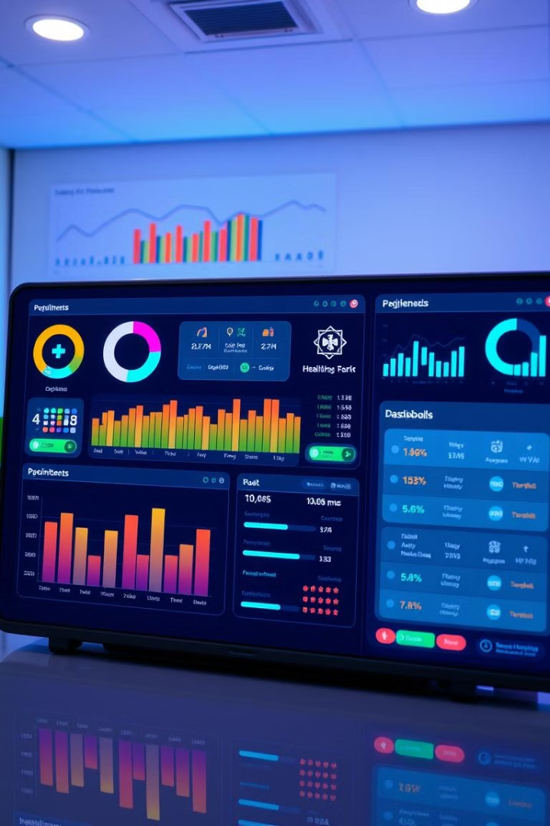
Fitness & Well-being Dashboard
Welcome to the Fitness & Well-being web app, a revolutionary platform designed to empower users to take control of their mental and physical well-being. We believe in using technology to make fitness accessible, enjoyable, and rewarding for everyone.

Slide 3
Project Overview
1
The Vision
2
User-Centric Design
Our vision is to create a comprehensive platform that goes beyond traditional fitness tracking. We aim to combine mental, physical, and cognitive fitness tools in one interactive dashboard, empowering users to achieve holistic well-being.
We are dedicated to designing a user-friendly interface that caters to a diverse range of users. The platform will be accessible to all, regardless of their fitness level or experience.
3
Community & Support
4
Gamified Engagement
We believe in fostering a supportive community where users can connect, share experiences, and motivate each other. The platform will offer features that encourage interaction and collaboration.
We will leverage gamification techniques to make fitness engaging and rewarding. Users will earn points, badges, and rewards for completing challenges and reaching their goals, promoting consistent participation and healthy habits.

Slide 4

Purpose & Mission
Purpose
Mission
To create an interactive dashboard that integrates a wide range of mental, physical, and cognitive fitness tools into one unified platform.
To leverage technology to make fitness accessible, enjoyable, and rewarding for everyone, regardless of their fitness level or experience.

Slide 5
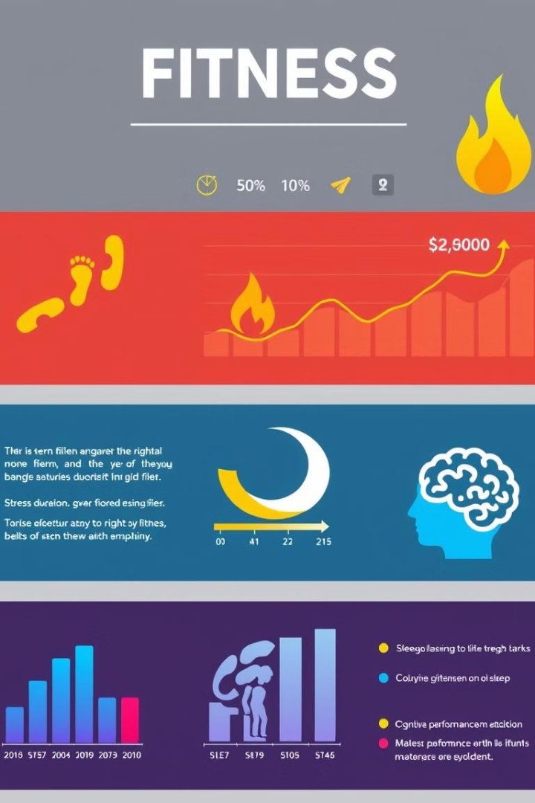
Tracking Metrics
**Category**
**Metrics Tracked**
Physical Fitness
Steps, distance, calories burned, heart rate, sleep duration, workout duration, muscle mass, body fat percentage
Mental Well-being
Stress levels, mood tracking, gratitude journaling, mindfulness exercises, sleep quality, cognitive function, focus and attention span
Cognitive Fitness
Memory games, brain training exercises, reaction time, problem-solving skills, attention to detail, language comprehension

Slide 6
Dashboard Features
Personalized Recommendations
Progress Tracking
Gamified Challenges
Users can track their progress over time, setting goals, monitoring their achievements, and celebrating milestones. The dashboard will provide visual representations of their data, making it easy to understand and stay motivated.
The dashboard will incorporate gamified elements such as challenges, badges, and rewards to incentivize users and make fitness fun. Completing challenges and achieving milestones will earn points and unlock new features.
The dashboard will provide personalized recommendations based on user goals, progress, and preferences. It will suggest tailored workouts, mindfulness exercises, and cognitive training activities.

Slide 7
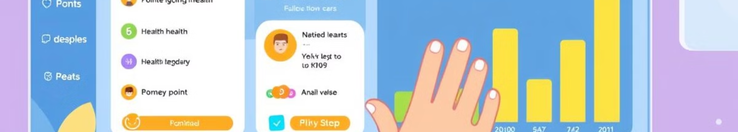



Gamified Engagement
Points System
Badges & Achievements
Meet Scheduling
Users earn points for completing activities, achieving goals, and participating in challenges.
Calendar for therapy sessions, games, and social events with reminders.
Unlock badges and achievements for completing specific tasks, reaching milestones, and demonstrating consistency.

Slide 8





User Empowerment
Goal Setting & Tracking
Self-Care & Mindfulness
Set personalized goals, track progress, and celebrate achievements, empowering users to take control of their well-being.
Integrate mindfulness exercises, stress management techniques, and gratitude journaling into daily routines.
Cognitive Fitness Training
Community & Support
Connect with a supportive community of like-minded individuals, share experiences, and motivate each other.
Challenge cognitive skills with interactive games and brain training exercises to enhance memory, focus, and attention.

Slide 9
Technology Stack
Frontend: Next.js, React
Backend: FastAPI, python , Open-cv, Nodejs,ExpressJs
Database: MongoDB
Machine Learning: Custom ML model for recommnedation
Virtual Meetup: Scheduling Virtual meetups using google meet api
3D/VR: Three.js
Containerization: Docker

Slide 10
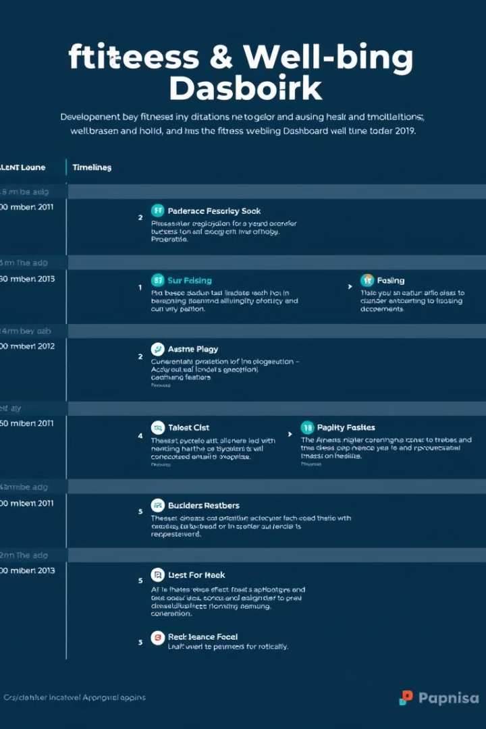
Next Steps
1
Phase 1: Development
Focus on building a robust platform with core features, including user profiles, activity tracking, and personalized recommendations.
2
Phase 2: Beta Testing
Release a beta version of the dashboard to a limited group of users for feedback and testing.
3
Phase 3: Launch & Marketing
Launch the official version of the dashboard, accompanied by a targeted marketing campaign to reach potential users.
4
Phase 4: Continuous Improvement
Continuously collect user feedback, implement updates and enhancements, and explore new features to enhance user experience.

